Slide 1

THE GREAT PIZZA ANALYTICS CHALLENGE

Slide 2


OVERVIEW
This mini project explores the IDC Pizza database using SQL. I cleaned the data, filtered important information, and analyzed sales to understand which pizzas sell the most, how prices vary, and how customers order. The goal was to practice SQL skills and get clear insights from a small dataset.

Slide 3
OBJECTIVE
To clean and inspect the IDC Pizza dataset for accuracy.
To explore and filter data using basic SQL queries.
To analyze sales performance using aggregations and joins.
To identify key insights such as top-selling categories, pricing patterns, and un-ordered pizzas.

Slide 4

PHASE 1
FOUNDATION & INSPECTION
Phase 1 focuses on setting up the IDC_Pizza database and doing basic data checks. I listed all unique pizza categories, inspected key fields like pizza_type_id, name, and ingredients (filling missing ones with “Missing Data”), and checked if any pizzas were missing prices. This ensured the data was clean before analysis.

Slide 5
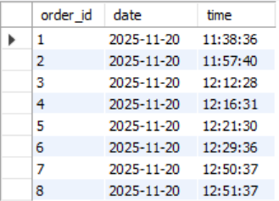
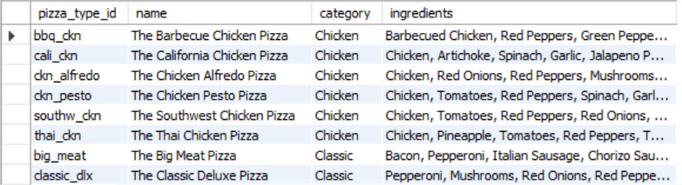
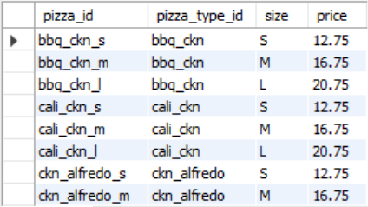
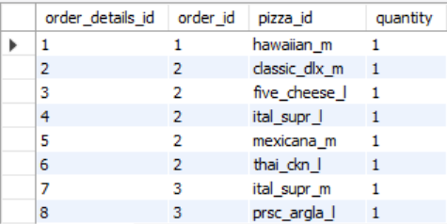
1. Install IDC_Pizza.dump as IDC_Pizza server
SELECT * FROM order_details;
SELECT * FROM orders;
SELECT * FROM pizza_types;
SELECT * FROM pizzas;

Slide 6
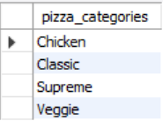
2. List all unique pizza categories (DISTINCT)
SELECT * FROM pizzas WHERE price IS NULL;

Slide 7
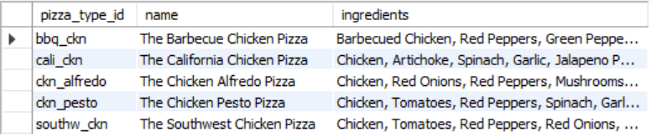
3. Display pizza_type_id, name, and ingredients, replacing NULL ingredients with "Missing Data". Show first 5 rows.
SELECT * FROM pizzas WHERE price IS NULL;

Slide 8
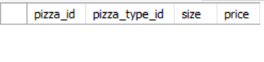
4. Check for pizzas missing a price (IS NULL).
SELECT * FROM pizzas WHERE price IS NULL;

Slide 9
PHASE 2
FILTERING & EXPLORATION
In this phase, I explored the dataset using different SQL filters. I checked orders from specific dates, sorted pizzas by price, found pizzas in selected sizes, searched price ranges, filtered pizzas with “Chicken” in the name, and identified orders placed on a certain date or after 8 PM. This helped me understand basic patterns in the data.

Slide 10
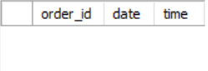
1. Orders placed on `'2015-01-01'`
(`SELECT` + `WHERE`).
SELECT * FROM orders WHERE date = '2015-01-01';

Slide 11
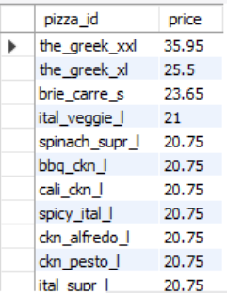
2. List pizzas with `price` descending.
SELECT pizza_id, price FROM pizzas ORDER BY price DESC;

Slide 12
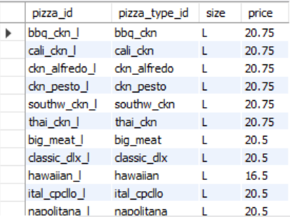
3. Pizzas sold in sizes `'L'` or `'XL'`.
SELECT * FROM pizzas WHERE size IN ('L', 'XL');

Slide 13
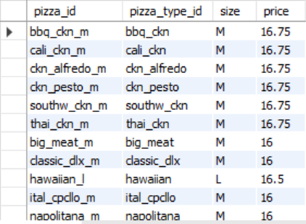
4. Pizzas priced between $15.00 and $17.00.
SELECT * FROM pizzas WHERE price BETWEEN 15.00 AND 17.00;

Slide 14
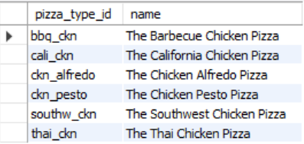
5. Pizzas with `"Chicken"` in the name.
SELECT pizza_type_id,name FROM pizza_types WHERE name LIKE '%chicken%'

Slide 15
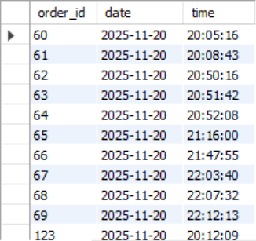
6. Orders on `'2015-02-15'` or placed after 8 PM.
SELECT * FROM orders WHERE date = '2015-02-15' OR time > '20:00:00';

Slide 16
PHASE 3
SALES PERFORMANCE
In this phase, I focused on analyzing sales using SQL aggregations. I calculated total pizzas sold, average prices, and total order values. I also compared sales across categories, identified top-selling categories, found pizzas that were never ordered, and checked price differences across sizes. This phase gave deeper insights into overall business performance.

Slide 17
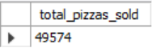
1. Total quantity of pizzas sold (`SUM`).
SELECT SUM(quantity) AS total_pizzas_sold FROM order_details;

Slide 18
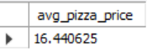
2. Average pizza price (`AVG`).
SELECT AVG(price) AS avg_pizza_price FROM pizzas;

Slide 19
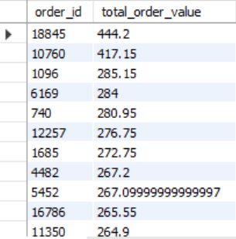
3. Total order value per order (`JOIN`, `SUM`, `GROUP BY`).
SELECT o.order_id, SUM(od.quantity * p.price) AS total_order_value FROM orders o JOIN order_details od ON o.order_id = od.order_id
JOIN pizzas p ON od.pizza_id = p.pizza_id GROUP BY o.order_id ORDER BY total_order_value DESC ;

Slide 20
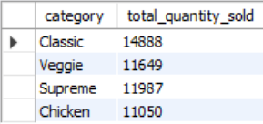
4. Total quantity sold per pizza category (`JOIN`, `GROUP BY`).
SELECT pt.category, SUM(od.quantity) AS total_quantity_sold FROM order_details od JOIN pizzas p ON od.pizza_id = p.pizza_id
JOIN pizza_types pt ON p.pizza_type_id = pt.pizza_type_id GROUP BY pt.category;

Slide 21
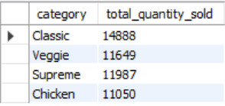
5. Categories with more than 5,000 pizzas sold (`HAVING`).
SELECT pt.category, SUM(od.quantity) AS total_quantity_sold FROM order_details od JOIN pizzas p ON od.pizza_id = p.pizza_id
JOIN pizza_types pt ON p.pizza_type_id = pt.pizza_type_id GROUP BY pt.category HAVING SUM(od.quantity) > 5000;

Slide 22
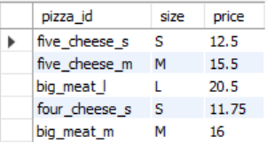
6. Pizzas never ordered (`LEFT/RIGHT JOIN`).
SELECT p.pizza_id, p.size, p.price FROM pizzas p LEFT JOIN order_details od ON p.pizza_id = od.pizza_id WHERE od.pizza_id IS NULL;

Slide 23
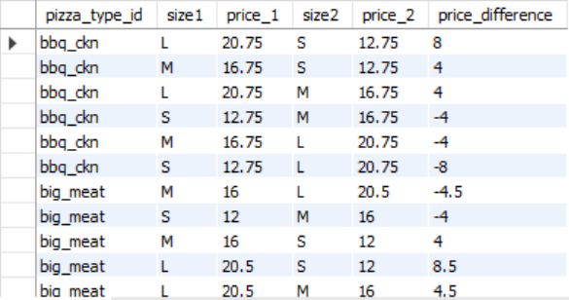
7. Price differences between different sizes of the same pizza (`SELF JOIN`).
SELECT p1.pizza_type_id, p1.size AS size1, p1.price AS price_1, p2.size AS size2, p2.price AS price_2, p1.price - p2.price AS price_difference
FROM pizzas p1 JOIN pizzas p2 ON p1.pizza_type_id = p2.pizza_type_id WHERE p1.size <> p2.size ORDER BY p1.pizza_type_id;

Slide 24
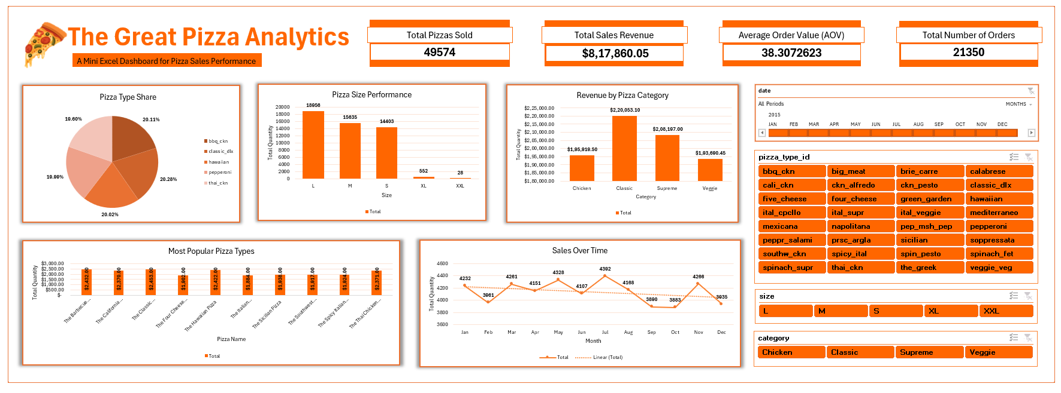
EXCEL DASHBOARD

Slide 25
INSIGHTS
49,574 pizzas sold — strong overall demand.
Classic category leads with 14,888 sales, followed by Supreme and Veggie.
Average pizza price: $16.44, indicating mid-premium positioning.
Customers prefer Medium & Large sizes, driving higher order values.
High-value orders exceed $400, showing strong multi-pizza purchases.
Price jumps between sizes are consistent: typically +$4 to +$8 from S→M→L.
The Greek Pizza has the highest price range, making it a premium upsell item.
Flavors across categories show broad variety (BBQ, Pesto, Alfredo, Veggie), attracting diverse customer tastes.

Slide 26
RECOMMENDATIONS
Promote Classic & Supreme pizzas—they contribute the highest sales volume.
Run targeted offers on Chicken pizzas to increase demand in the lowest-performing category.
Bundle Medium & Large pizzas since these sizes drive most revenue.
Highlight premium upsells like The Greek XXL to boost order value.
Introduce pricing combos aligned with common size price gaps (+$4 to +$8) to encourage upgrades.
Expand veggie-based options as Veggie is the second-strongest category.

Slide 27
THANK YOU!

